Slide 1
Let's play a game
(match the opposites)
https://wordwall.net/play/5199/284/516

Slide 2
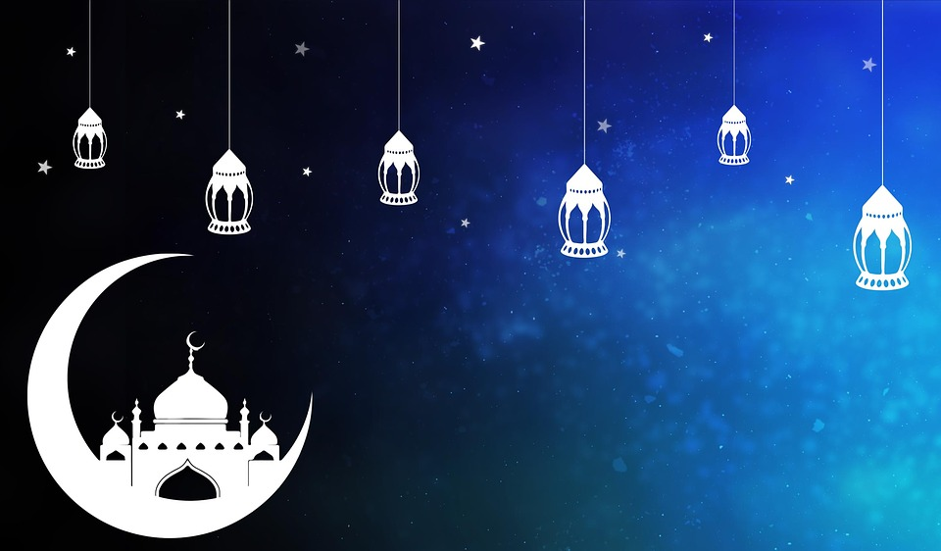

What comes to your mind ?

Slide 3

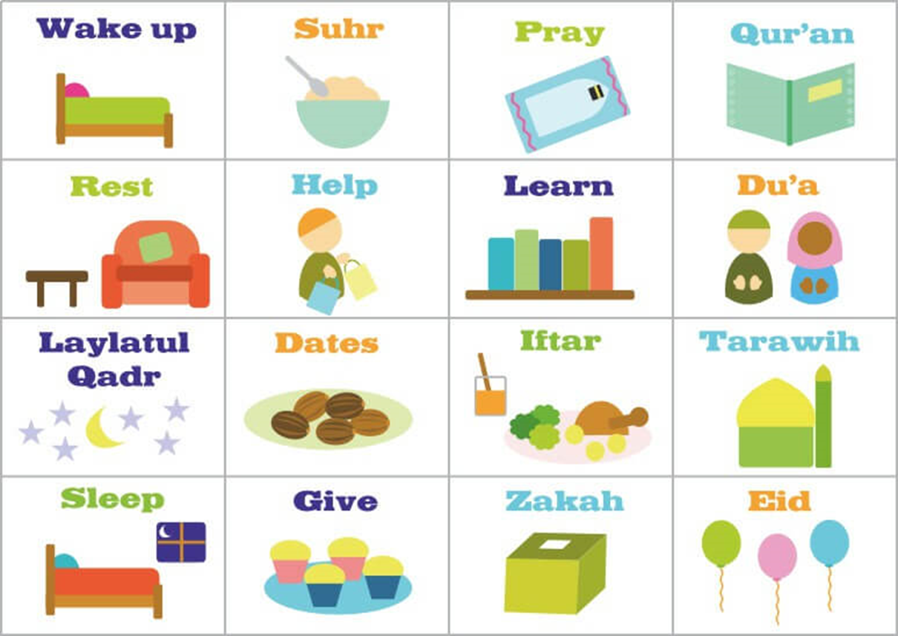
1
What will you do in Ramadan ?

Slide 4
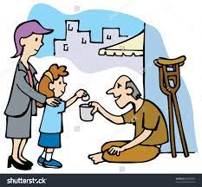
Is this a good or bad behavior ?

Slide 5
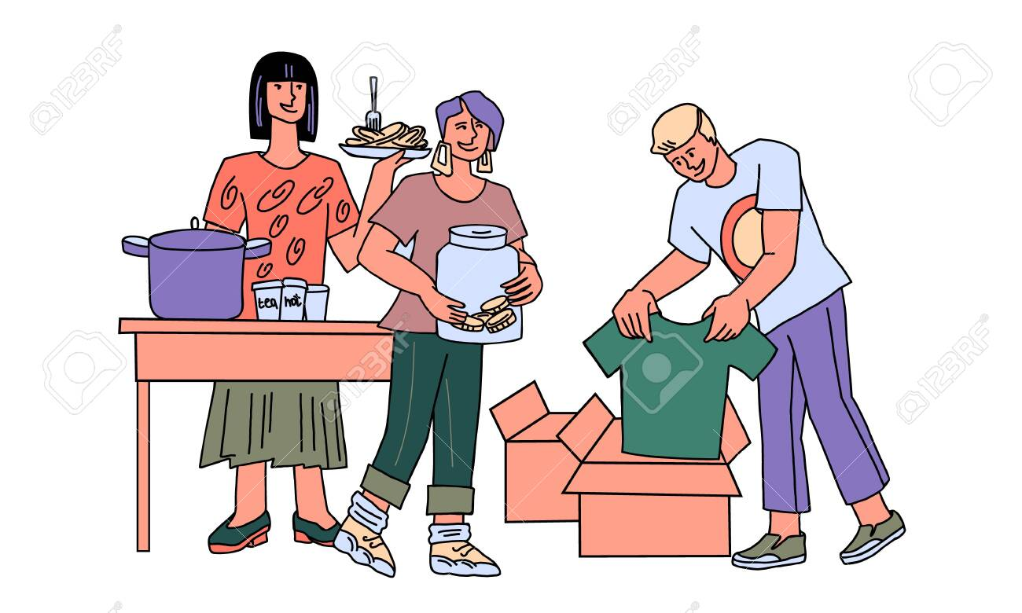
How can we help the poor ?

Slide 6
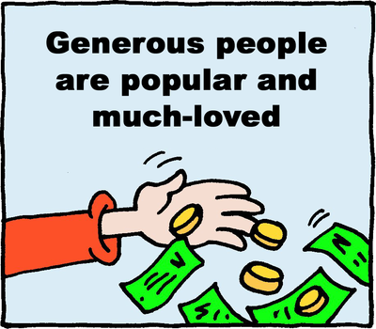
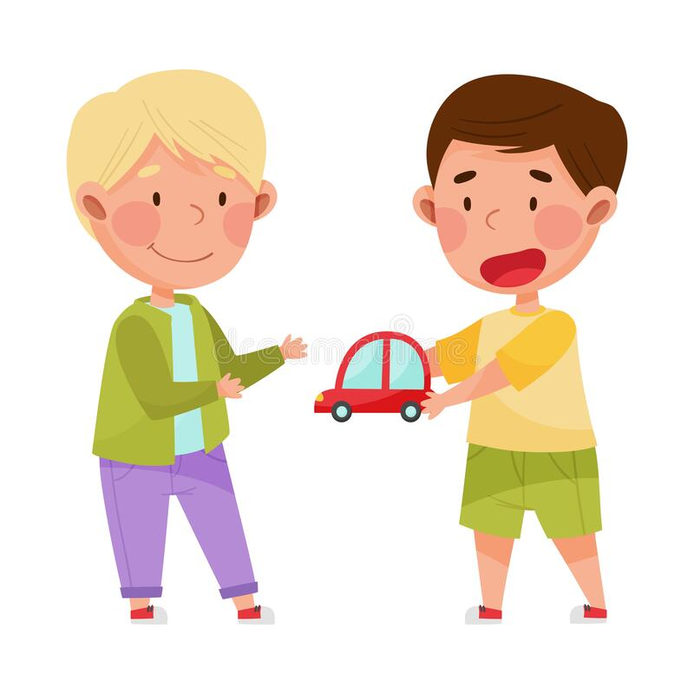
People who are generous are willing to give money, help and kindness.

Slide 7
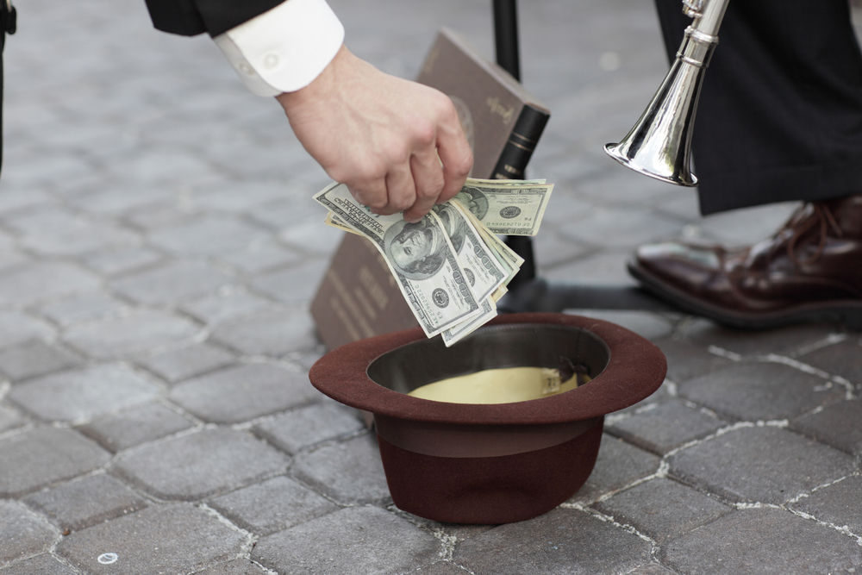
generous

Slide 8
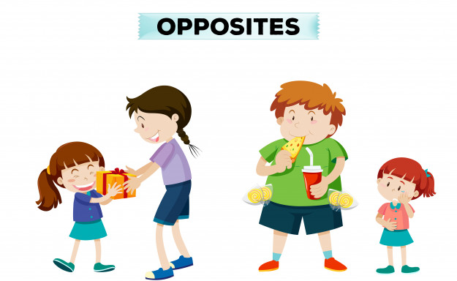
generous
selfish

Slide 9
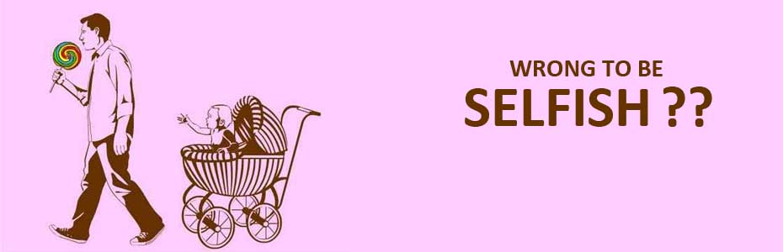
selfish
A selfish person only thinks of his own advantage.

Slide 10
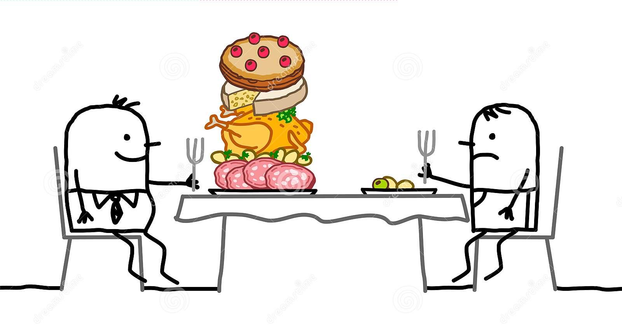
a
b

Slide 11


They are so imaginative.
good at thinking of new, original, and clever ideas.

Slide 12
imaginative

Slide 13
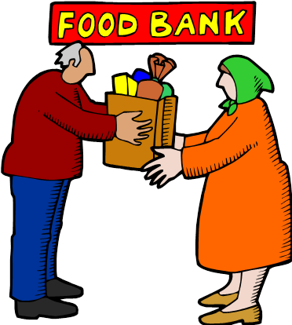
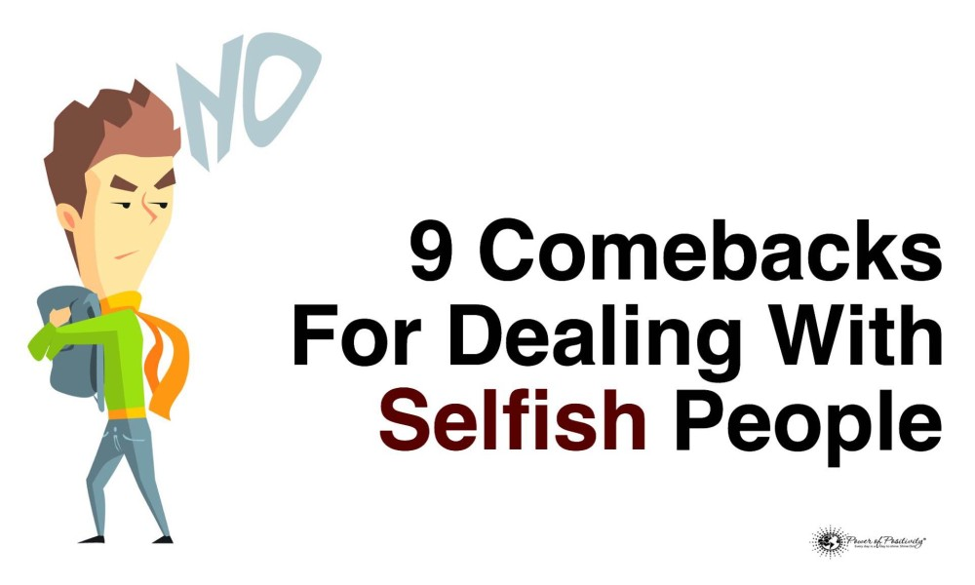


generous (adj.)
imaginative (adj.)
selfish (adj.)

Slide 14

Student’s Book
Page 58

Slide 15


Slide 16

Check your answers!

Slide 17
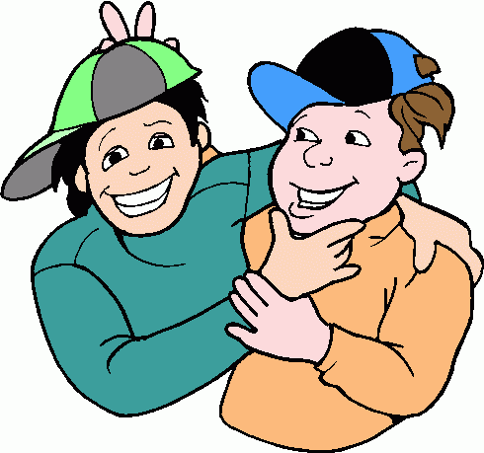
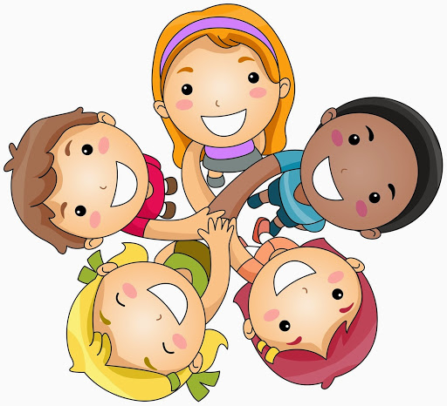
generous
friendly
imaginative
shy
selfish
impatient
1-Anwar likes being with people.

Slide 18
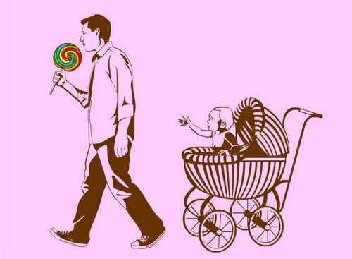

generous
imaginative
selfish
shy
impatient
2- Jamal doesn’t like sharing things.

Slide 19
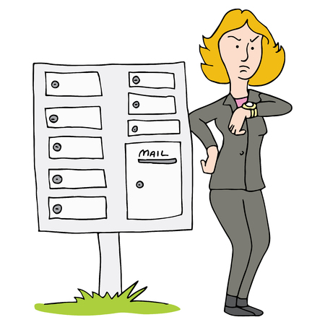
generous
imaginative
impatient
shy
3- Nisreen can’t wait for things.

Slide 20
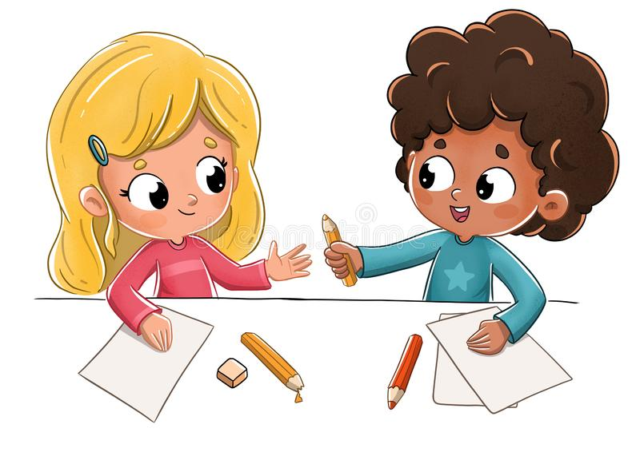
generous
imaginative
shy
4- Ali likes giving people things.

Slide 21
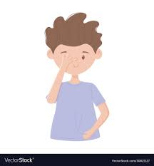
shy
imaginative
5- Nader is nervous with people.

Slide 22

imaginative
6- Zahra has a lot of ideas.

Slide 23
generous
selfish
shy
impatient
imaginative

Slide 24


Slide 26
Read your answers.

Slide 27

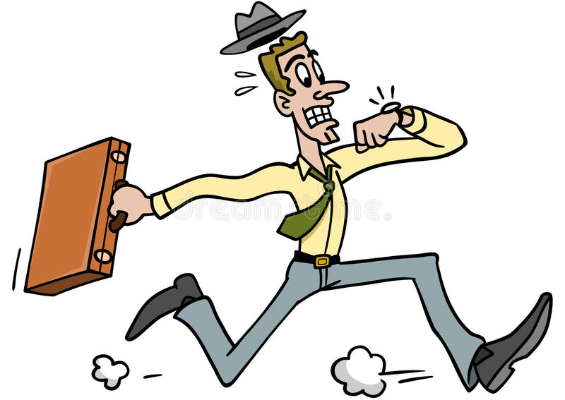
shouldn’t
1. They ………………...…………….. be late for work.

Slide 28


should
2. You ……………………….. work in business.

Slide 29
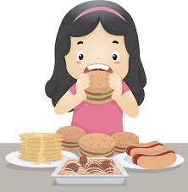
shouldn’t
3. I ………………………..…….. eat too much.

Slide 30
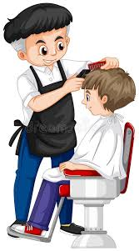
Why don’t you
4. ………………...………………………..……….. have a hair cut?

Slide 31
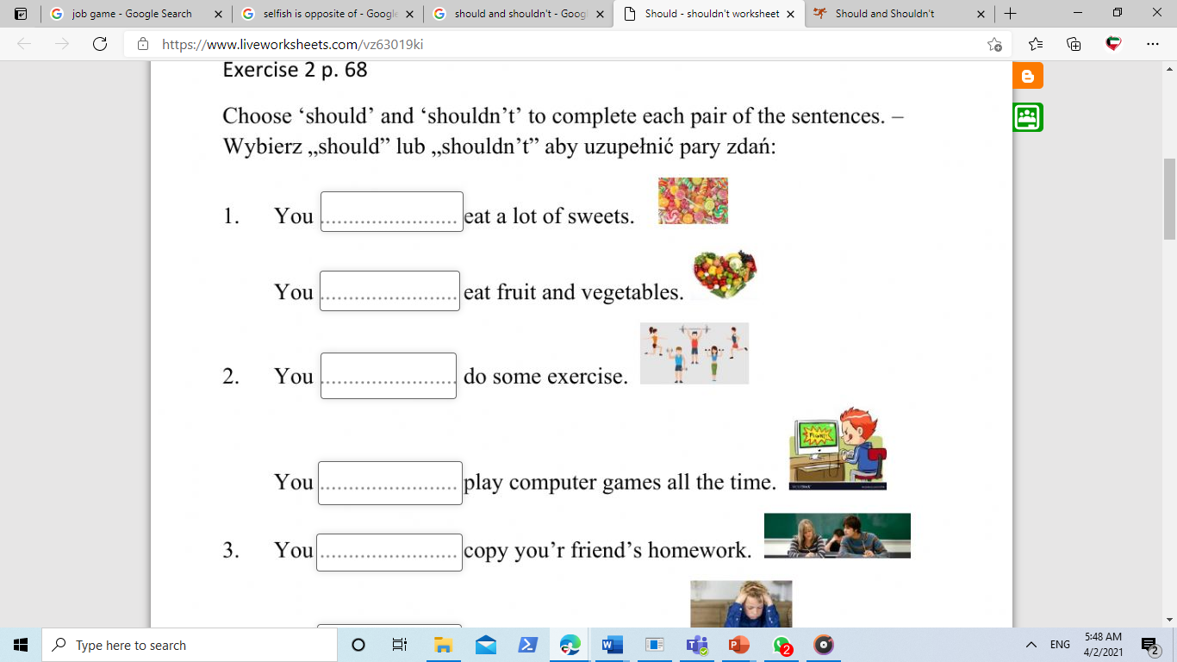
Choose should or shouldn’t to complete the sentences

Slide 32
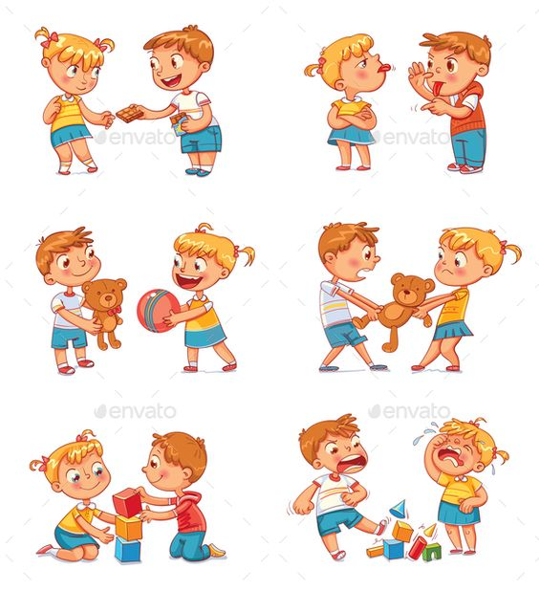
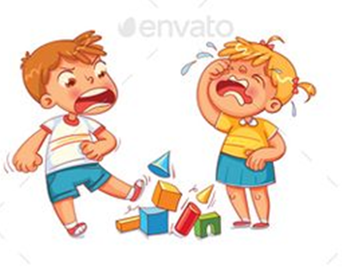
Choose the pictures that show good behavior
a
b
c
d

Slide 33
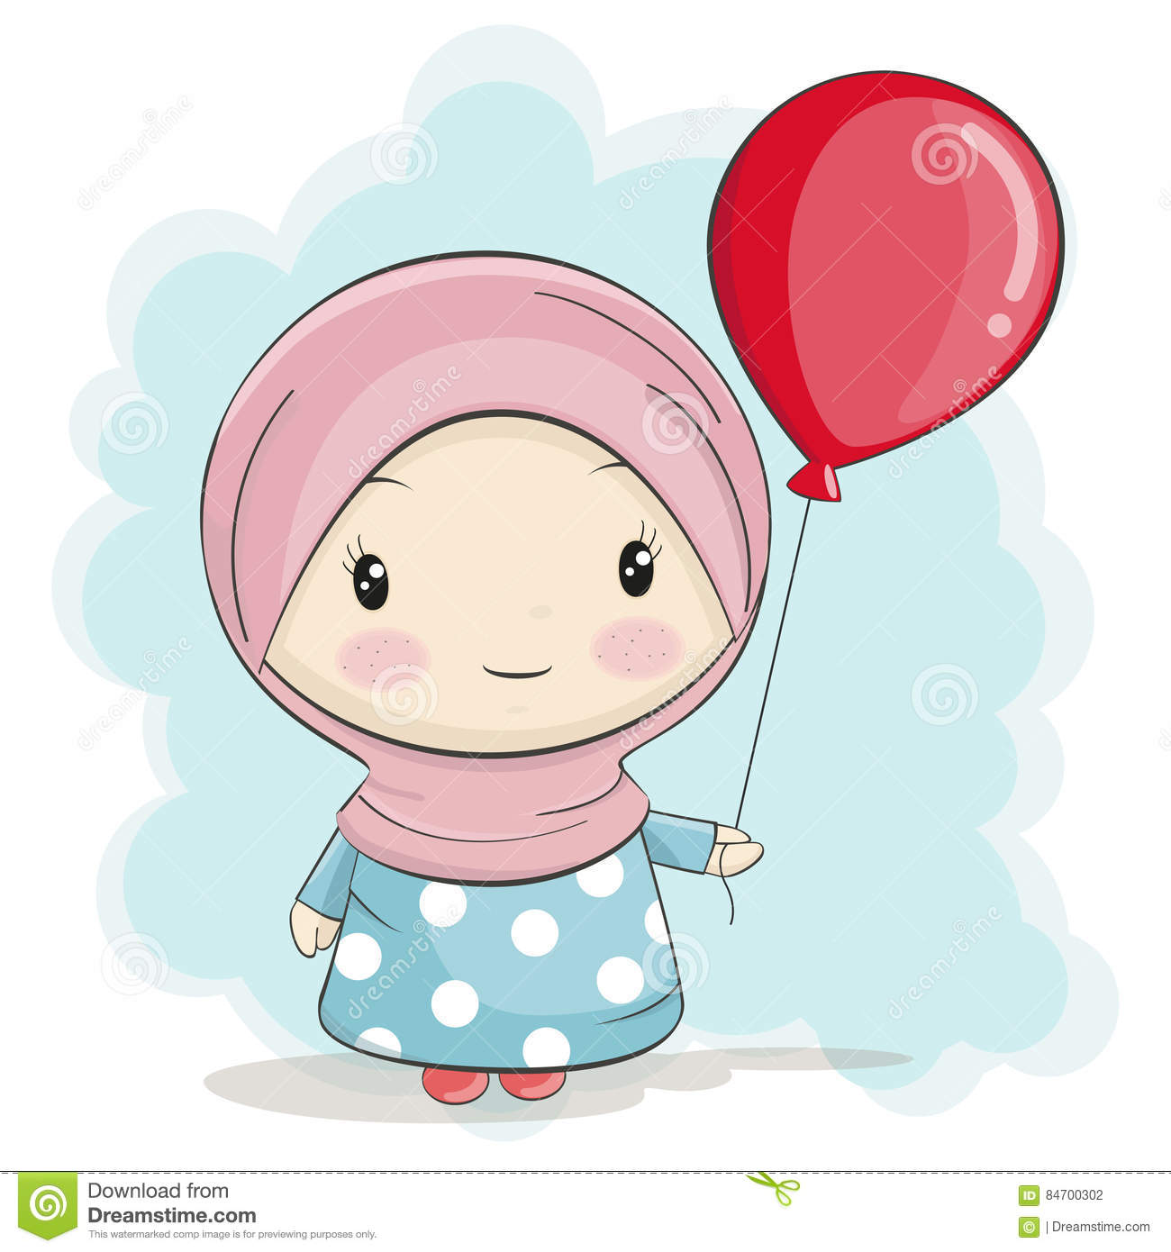
Imagine this is your
little sister

Slide 34

write two sentences to your little sister
about the things she should do in Ramadan
1- You should__________
2- You should __________

Slide 35
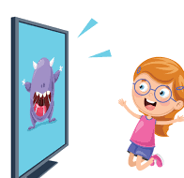
write two sentences to your little sister
about the things she shouldn't do in Ramadan
1- You shouldn’t __________
2- You shouldn’t __________

Slide 36
Please enter the link
https://wordwall.net/play/4977/252/616

Slide 37
Complete the word with the missing letters
sel _ _ _ _

Slide 38
Complete the word with the missing letters
ima_ _ na _ _ ve

Slide 39


